Slide 1
Operating system structure
System calls

Slide 2
overview
System calls provide an interface to the services made available by an operating system. These calls are generally available as routines written in C and C++, although certain low-level tasks (for example, tasks where hardware must be accessed directly) may have to be written using assembly-language instructions

Slide 3
application programming interface (API)
The API specifies a set of functions that are available to an application programmer, including the parameters that are passed to each function and the return values the programmer can expect.
Three of the most common APIs available to application programmers are the Windows API for Windows systems, the POSIX API for POSIX-based systems(which include virtually all versions of UNIX, Linux, and Mac OSX), and the Java API for programs that run on the Java virtual machine.
A programmer accesses an API via a library of code provided by the operating system. In the case of UNIX and Linux for programs written in the C language, the library is called libc.

Slide 4
Why would an application programmer prefer programming according to an API rather than invoking actual system calls?
The functions that make up an API typically invoke the actual system calls on behalf of the application programmer
program portability
An application programmer designing a program using an API can expect her program to compile and run on any system that supports the same API .
actual system calls can often be more detailed and difficult to work with than the API available to an application programmer.
Nevertheless, there often exists a strong correlation between a function in the API and its associated system call within the kernel.

Slide 5
System call interface
For most programming languages, the run-time support system (a set of functions built into libraries included with a compiler) provides a system call interface that serves as the link to system calls made available by the operating system.
The system-call interface intercepts function calls in the API and invokes the necessary system calls within the operating system.
Typically, a number is associated with each system call, and the system-call interface maintains a table indexed according to these numbers.
It then invokes the intended system call in the operating-system kernel and returns the status of the system call and any return values

Slide 6
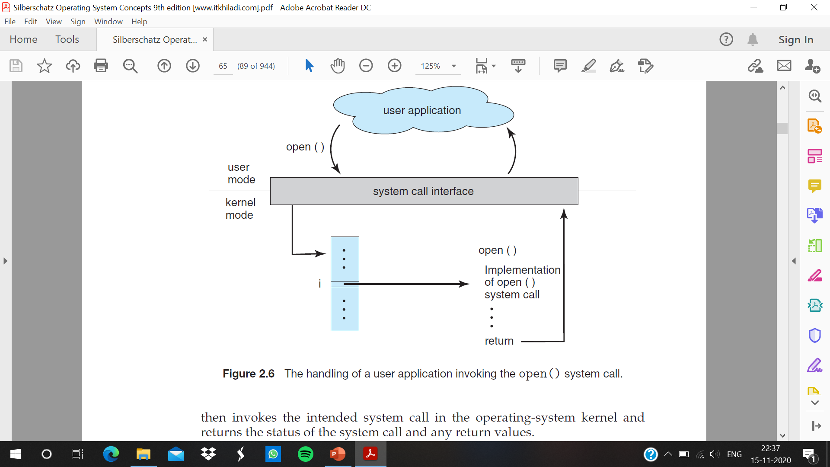

Slide 7
Three general methods are used to pass parameters to the operating system
The simplest approach is to pass the parameters in registers
The parameters are generally stored in a block, or table, in memory, and the address of the block is passed as a parameter in a register. This is the approach taken by Linux and Solaris.
Parameters also can be placed, or pushed, onto the stack by the program and popped off the stack by the operating system. Some operating systems prefer the block or stack method because those approaches do not limit the number or length of parameters being passed.

Slide 8
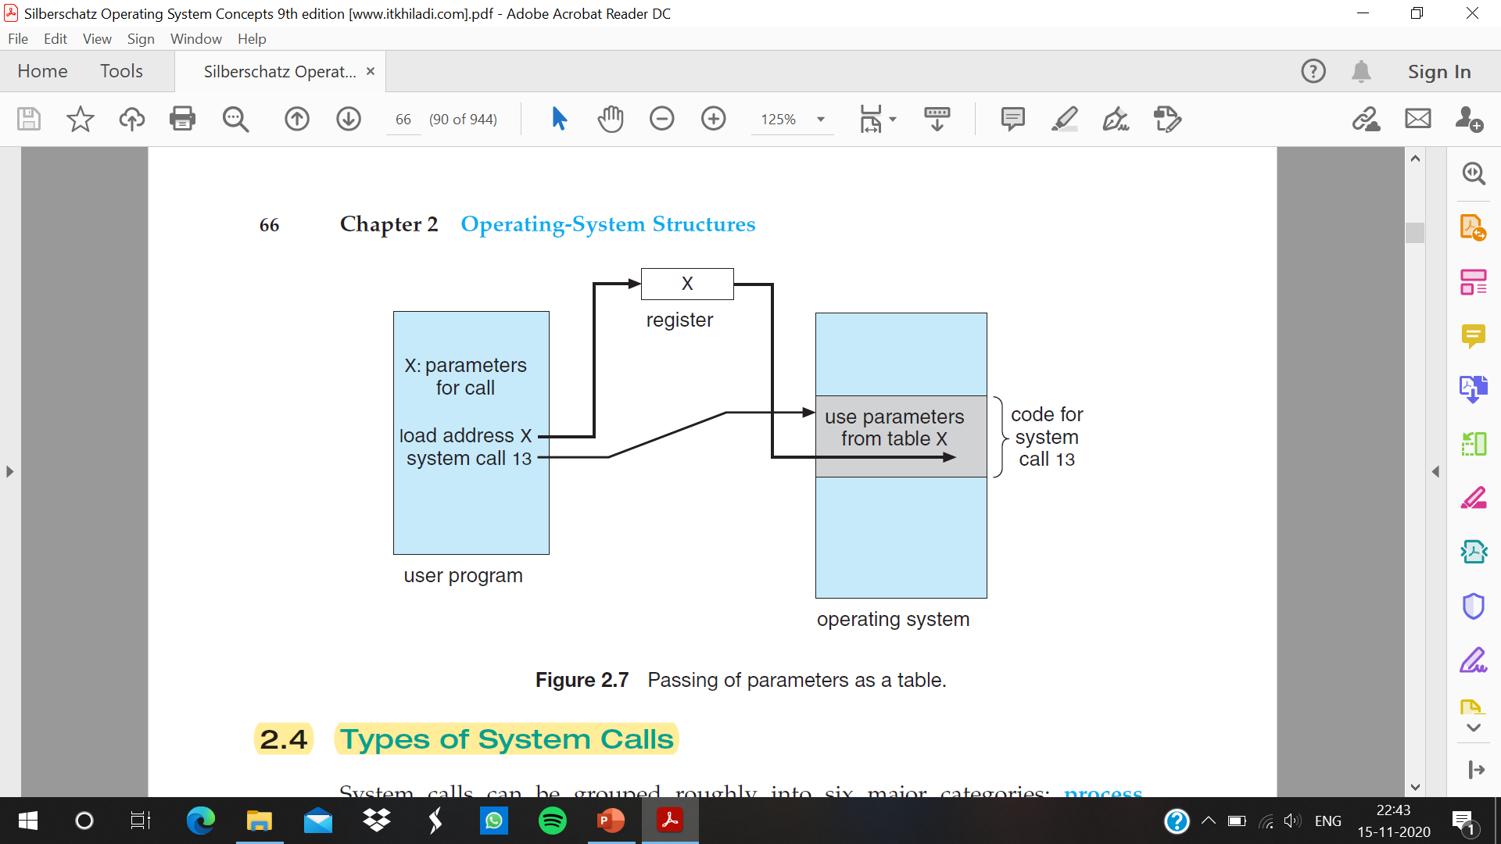

Slide 9
Types of system calls
System calls can be grouped roughly into six major categories:
process control
file manipulation
device manipulation
information maintenance
Communications
protection

Slide 10
Process Control
A running program needs to be able to halt its execution either normally (end()) or abnormally (abort()).
If a system call is made to terminate the currently running program abnormally, or if the program runs into a problem and causes an error trap, a dump of memory is sometimes taken and an error message generated
The dump is written to disk and may be examined by a debugger—a system program designed to aid the programmer in finding and correcting errors, or bugs—to determine the cause of the problem.
Under either normal or abnormal circumstances, the operating system must transfer control to the invoking command interpreter.

Slide 11
System calls in process control
◦ end, abort
◦ load, execute
◦ create process, terminate process
◦ get process attributes, set process attributes
◦ wait for time
◦ wait event, signal event
◦ allocate and free memory

Slide 12
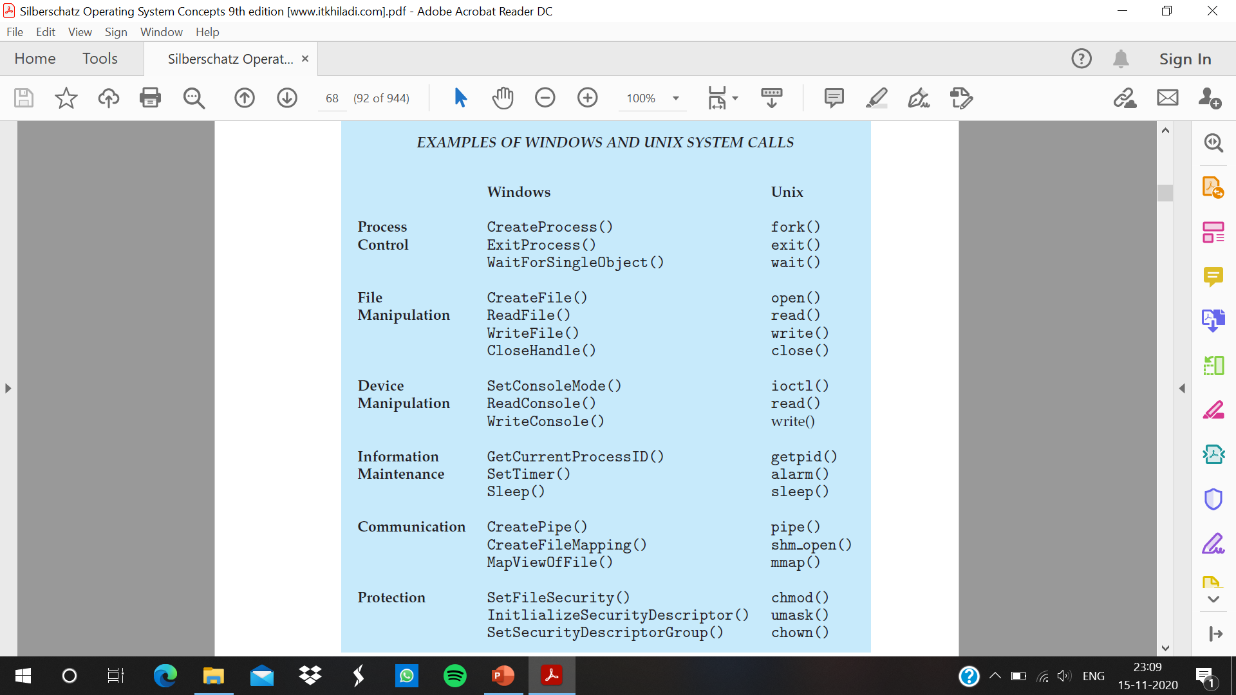

Slide 13
Lock()
Quite often, two or more processes may share data. To ensure the integrity of the data being shared, operating systems often provide system calls allowing a process to lock shared data. Then, no other process can access the data until the lock is released. Typically, such system calls include acquire lock() and release lock(). System calls of these types, dealing with the coordination of concurrent processes

Slide 14
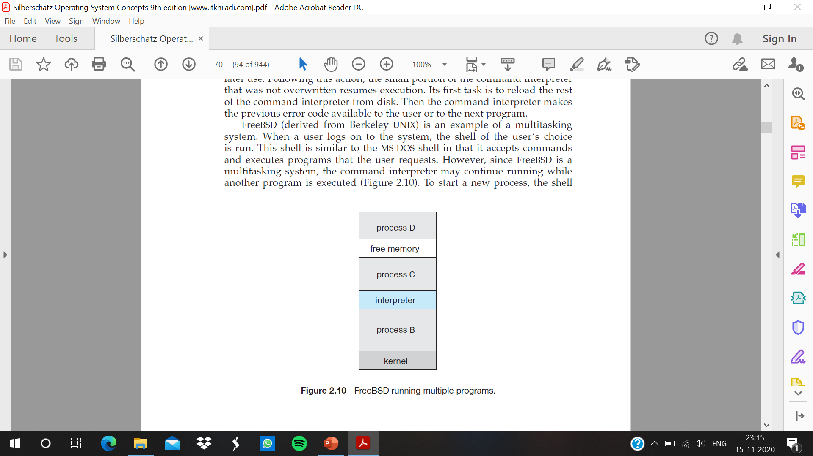
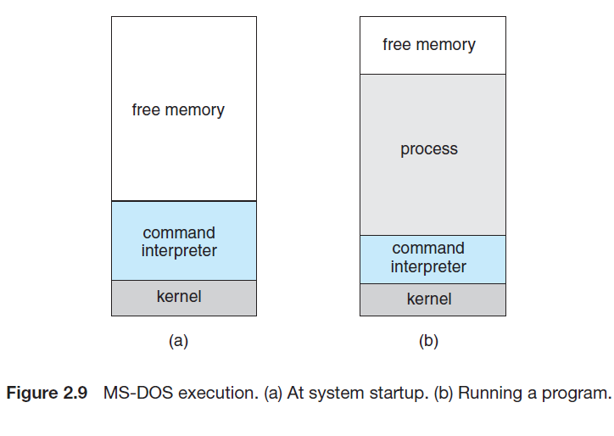
Examples

Slide 15
File Management
able to create() and delete() files. Once the file is created, we need to open() it and to use it. We may also read(), write(), or reposition() .Finally, we need to close() the file, indicating that we are no longer using it.
File attributes include the filename, file type, protection codes, accounting information, and so on. At least two system calls, get file attributes() and set file attributes(), are required for this function. Some operating systems provide many more calls, such as calls for file move() and copy()

Slide 16
System Calls in File Management
◦ create file, delete file
◦ open, close
◦ read, write, reposition
◦ get file attributes, set file attributes

Slide 17
Device Management
A process may need several resources to execute—main memory, disk drives, access to files, and so on. If the resources are available, they can be granted , and control can be returned to the user process. Otherwise, the process will have to wait until sufficient resources are available.
A system with multiple users may require us to first request() a device, to ensure exclusive use of it. After we are finished with the device, we release() it. These functions are similar to the open() and close() system calls for files. Other operating systems allow unmanaged access to devices.
Once the device has been requested (and allocated to us), we can read(), write(), and (possibly) reposition() the device.

Slide 18
System Calls in Device Management
◦ request device, release device
◦ read, write, reposition
◦ get device attributes, set device attributes
◦ logically attach or detach devices

Slide 19
Information Maintenance
Some system call’s : the purpose of transferring information between the user program and the operating system
Another set of system calls is helpful in debugging a program. Many systems provide system calls to dump() memory. This provision is useful for debugging.
A program trace lists each system call as it is executed. Even microprocessors provide a CPU mode known as single step, in which a trap is executed by the CPU after every instruction. The trap is usually caught by a debugger.
Many operating systems provide a time profile of a program to indicate the amount of time that the program executes at a particular location or set of locations.

Slide 20
System Calls in Information Maintenance
◦ get time or date, set time or date
◦ get system data, set system data
◦ get process, file, or device attributes
◦ set process, file, or device attributes

Slide 21
Communication
There are two common models of inter process communication: the message passing model and the shared-memory model
In the message-passing model, the communicating processes exchange messages with one another to transfer information. Messages can be exchanged between the processes either directly or indirectly through a common mailbox.
In the shared-memory model, processes use shared memory create() and shared memory attach() system calls to create and gain access to regions of memory owned by other processes.

Slide 22
System Calls in Communication
◦ create, delete communication connection
◦ send, receive messages
◦ transfer status information
◦ attach or detach remote devices

Slide 23
Protection
Protection provides a mechanism for controlling access to the resources provided by a computer system. Historically, protection was a concern only on Multi-programmed computer systems with several users.
However, with the advent of networking and the Internet, all computer systems, from servers to mobile handheld devices, must be concerned with protection.
Typically, system calls providing protection include set permission() and get permission(), which manipulate the permission settings of resources such as files and disks. The allow user() and deny user() system calls specify whether particular users can—or cannot—be allowed access to certain resources.

